Slide 1
Trentino sports
KGE project 2022
Erik Nielsen, Shandy Darma
Notes:
ERIK Nielsen

Slide 2
Objectives
The main objective of the project is to produce a Knowledge Graph (KG) given a certain Purpose.
The goals were:
Get the resources to satisfy the Trentino Sport Purpose
Exploit iTelos Methodology to engineer a KG
Build a KG
Exploit the KG
Notes:
ERIK Nielsen

Slide 3
iTelos Methodology
iTelos is the used methodology to do this project.
Consist in 4+1 steps:
Phase 0
Inception
Informal modellling
Formal modelling
KGC
Notes:
ERIK Nielsen

Slide 4
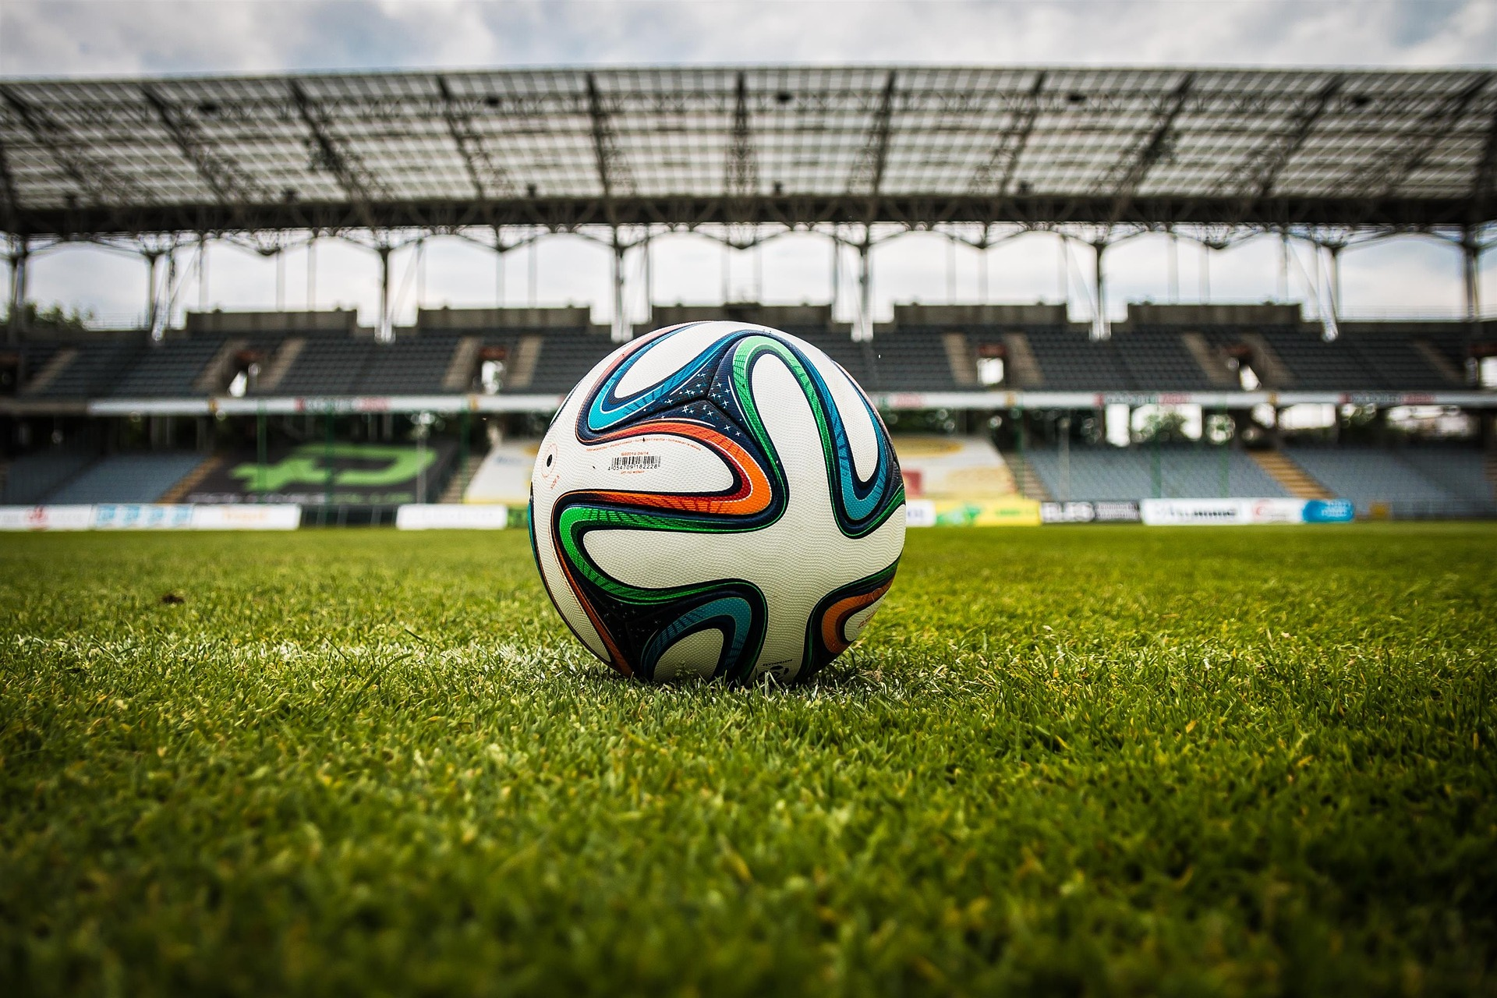
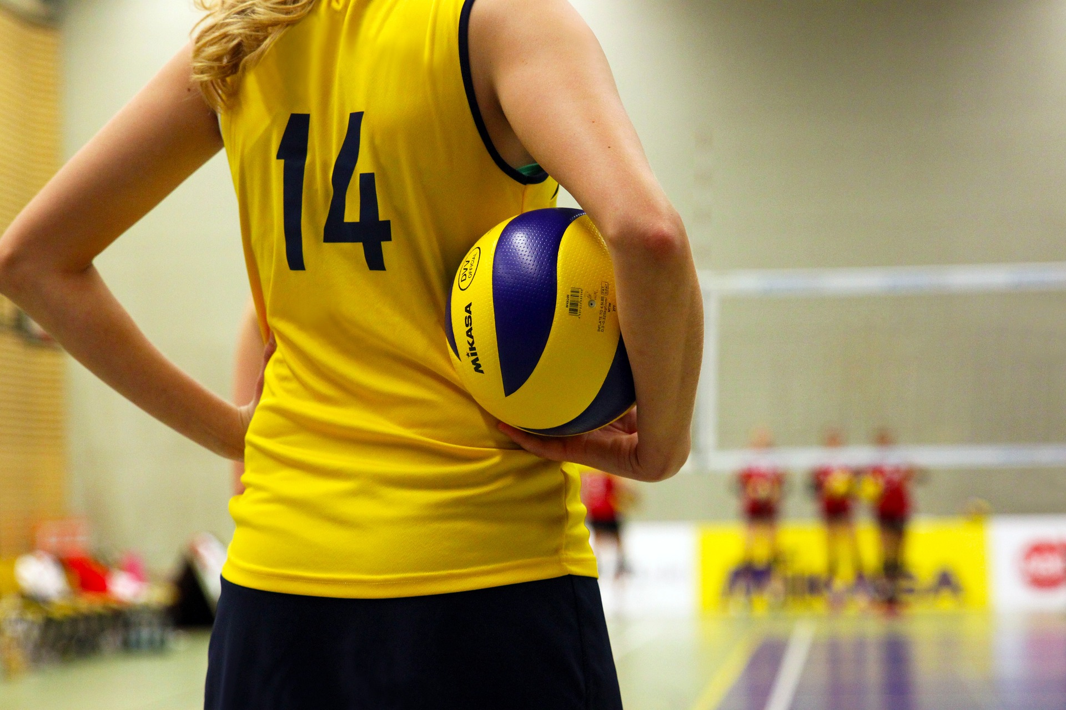
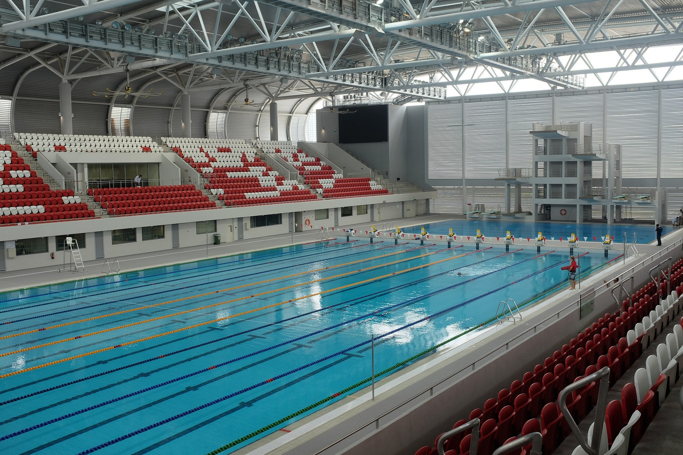
Purpose of the project
"A service which help the users to find information about sport facilities in Trentino."
Notes:
ERIK Nielsen

Slide 5
Domain of Interest
Space: Autonomous Province of Trento
The purpose is clear that the space boundaries are Trentino region
Time: June 2022 to June 2023
Given the resources, this became the best range of time
Notes:
Shandy Darma

Slide 6






Sources
Data:
Knowledge:
Notes:
Shandy Darma

Slide 7
Purpose Formalization
Scenarios:
Scenario 1: In the municipality of Trento, between 08:00 - 22:00, standard weekday.
Scenario 2: In the municipality of Trento, between 08:00 - 22:00, one week before the Trento Tennis Open.
Scenario 3: In the municipality of Trento, during the evening, Trentino Volley home game day.
Personas: six different personas with different backgrounds, ages, genders, and needs.
Notes:
Shandy Darma

Slide 8
Purpose Formalization
Competency Questions: Total of 6 CQs out of 6 personas
Entities:
Common Entities: Location, Event, Trento Public Transportation
Core Entities: Sport, Facility, Association Group
Contextual Entities: Facilities Pricing, Transport Pricing, Availability, Opening Hours
Notes:
Shandy Darma

Slide 9
Inception
WebSites Scraped to collect Data:
Comune di Trento Sport Facility Page Website
Comune di Arco Sport Facility Page Website
Pagine Gialle
Schema Modelling:
First gist how the ETG model should look like after the purpose formalization
KGC
Apply the model to collected data
Notes:
ERIK Nielsen

Slide 10
Informal Modelling
This phase aim to build a non-complete schema of the KG
The main steps are:
Create a ER Model
Build the Teleology
Do a first filtering and alignment of the datasets
Notes:
ERIK Nielsen

Slide 11
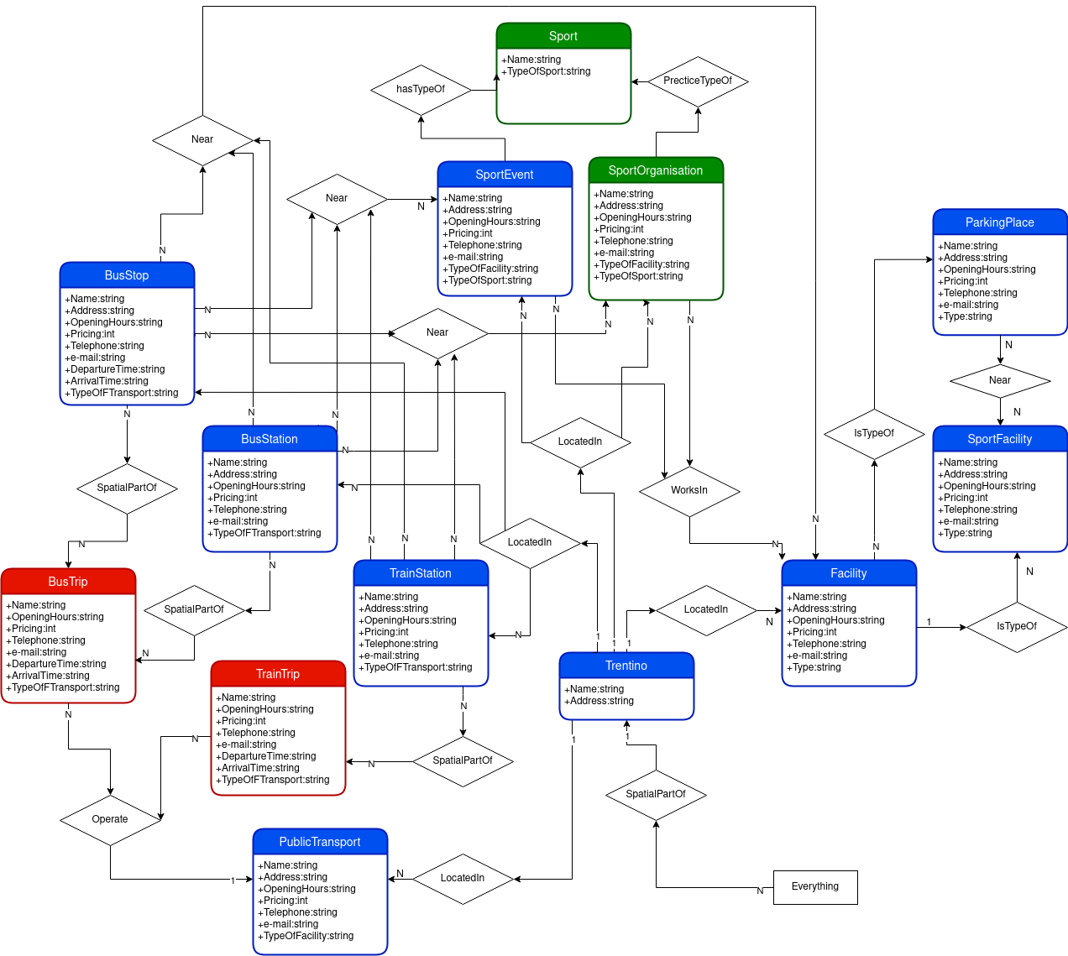
ER model Description
Defining all the ETypes by Object, Function and Action,
Defining all objects as subclass of Everything,
Defining all objects as “Located in” Trentino Region as it is the spatial area of the Purpose,
Linking all objects with their corresponding functions,
Adding and filtering all actions,
Adding colors to the entities based on their categories: Blue for Common Entities, Green for Core Entities, Red for Contextual Entities
Notes:
ERIK Nielsen

Slide 12
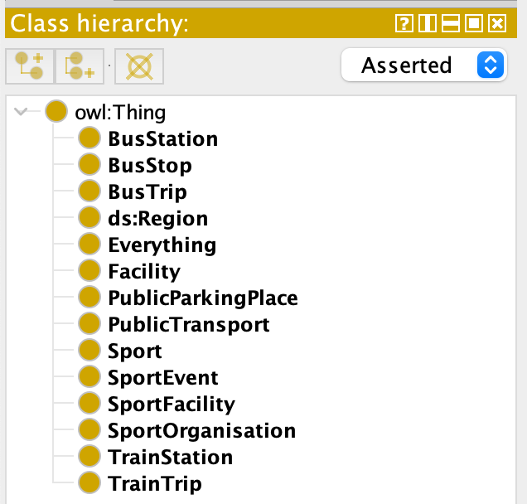

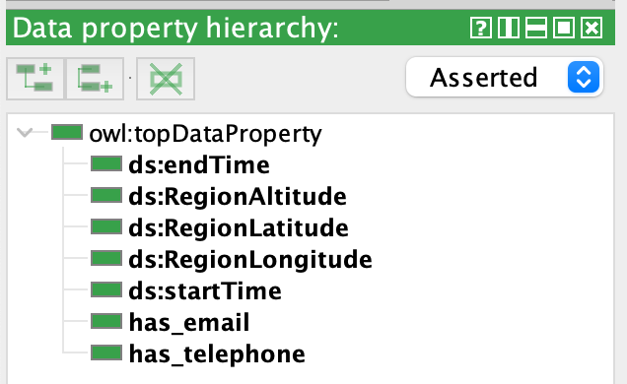
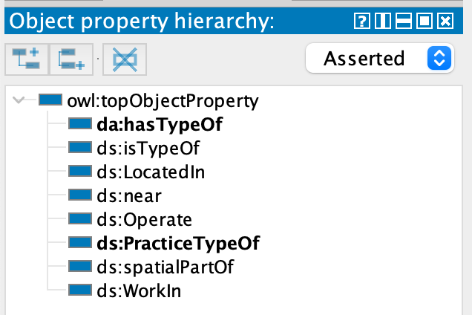
Teleology Building
Implement the ER into protégé
Notes:
ERIK Nielsen

Slide 13
Dataset Filtering and Alignment
ImpiantiSportivi.csv | Arco_Web_ Facilities.json | Trento_Web_ Facilities.json | PagineGialle_ Web_Facilities.json
WKT; Impianto; Ubicazione; Comcat; Gestione; Disciplina; Discipline; Strutture; Tipologia; Management; Typology | Title; Infos: Indirizzo; Telefono; E-Mail; Website | Title; Infos: Indirizzo; E-Mail; Telefono; Indirizzo Web; Impianto gestito da; Tipologia di luogo | Title; Address; Openings; Telephone; Type_Of_Facility;
Notes:
ERIK Nielsen

Slide 14
Formal Modelling
This step is trivial to retrieve the final schema and the ETG
The key aspect are:
Build ontology
Align Teleology to the Ontology
Align the Teleontology to the concept-language
Retrieve ETG
Notes:
Shandy Darma

Slide 15
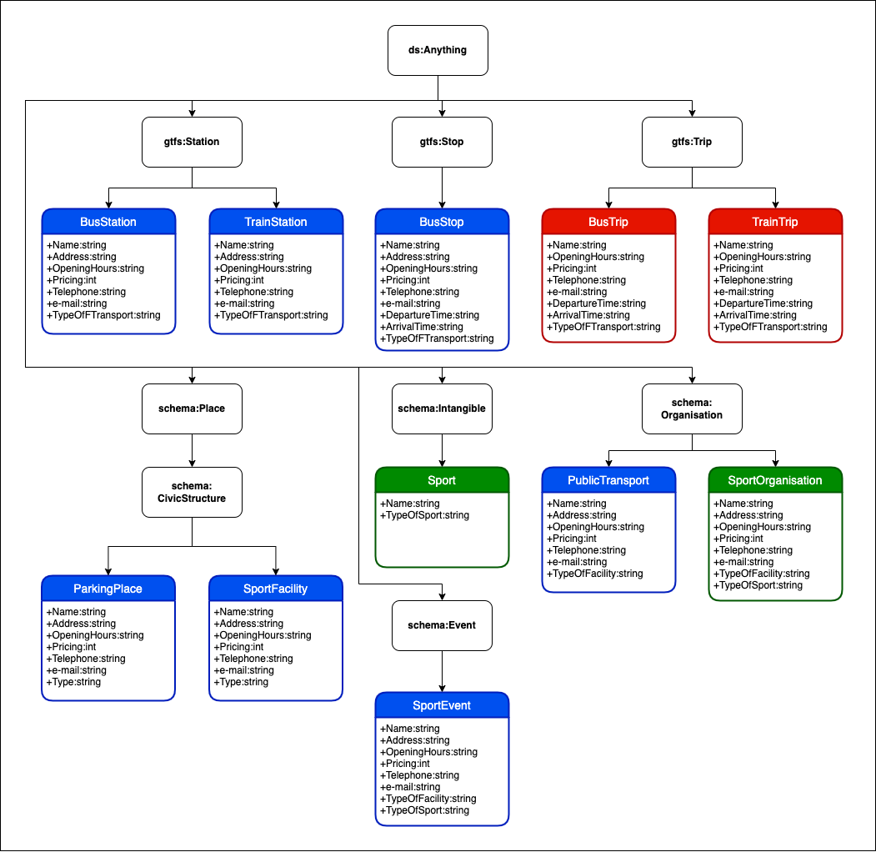
Teleontology Generation
Reference Ontologies:
GTFS: Station, Stop, Trip
Schema.org: Event, Place, CivicStructure, Intangible, Organisation
Notes:
Shandy Darma

Slide 16
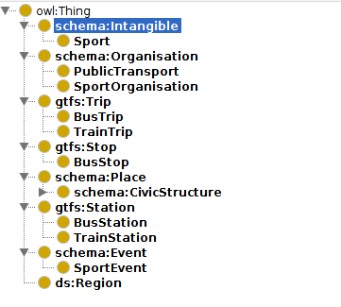
Schema Alignment
The Ontology and Teleology must be aligned:
Main tool used is protegé
the gist is to give a hierarchy from teleology to ontology
each teleology entity aligned to his ontology “super-entity”
Teleontology creation
Notes:
Shandy Darma

Slide 17
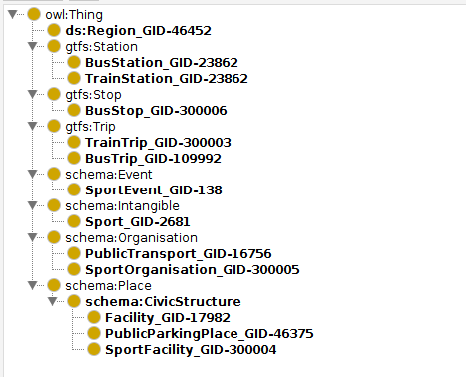
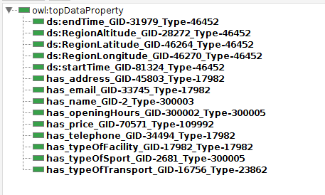
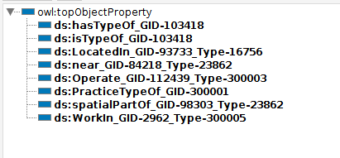
Language Alignment
Assigning identifier to a concept
To resolve ambiguity present in natural language
Executed with KOS, by utilising UKC
Notes:
ERIK Nielsen
example of ambiguity: bat (the flying mammal) vs bat (baseball bat)

Slide 18
Dataset Alignment
Due to the heterogeneity of the formats some alignments had to be done
All files transformed into CSV
From JSON to CSV some features had to be fixed:
example: openingHours in the scraped dataset from PagineGialle
each day rearrange into a single string called openingHours
Notes:
ERIK Nielsen

Slide 19
KGC
Some trivial steps are done to retrieve the finale KG:
Entity Matching
Data Mapping
Construct the final KG
Notes:
ERIK Nielsen

Slide 20
Entity Matching
Data integration related step:
Find a unique identifier for each entity in different dataset
Two ways adopted to do the match:
Already collected IDs in the datasets (Open trentino and Trasporti data)
Scraped dataset used Edit Distance for name and address to create a unique ID. Some manual tweaks were needed
Notes:
ERIK Nielsen

Slide 21
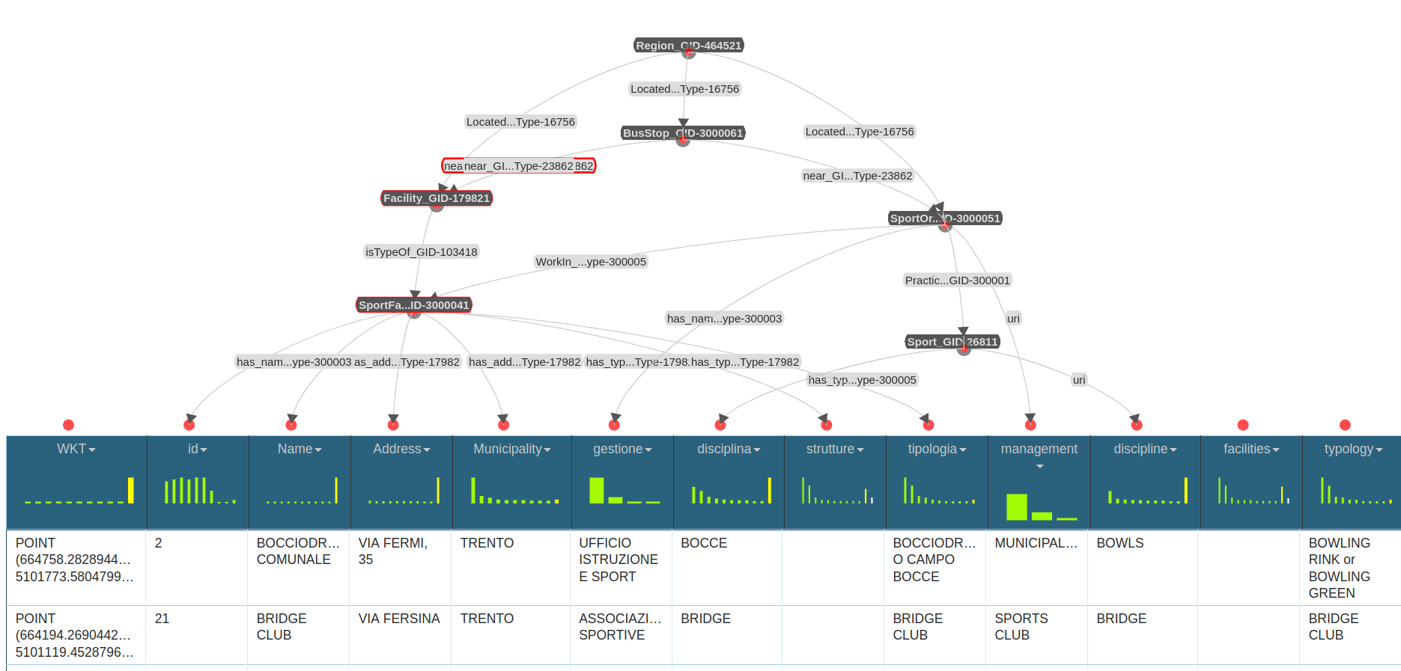
Data Mapping
Link the datasets to the ETG:
KarmaLinker tool used
Link each entity to an ID in the dataset
Link each data property to the entity
Retrieve the RDF files
Notes:
ERIK Nielsen

Slide 22
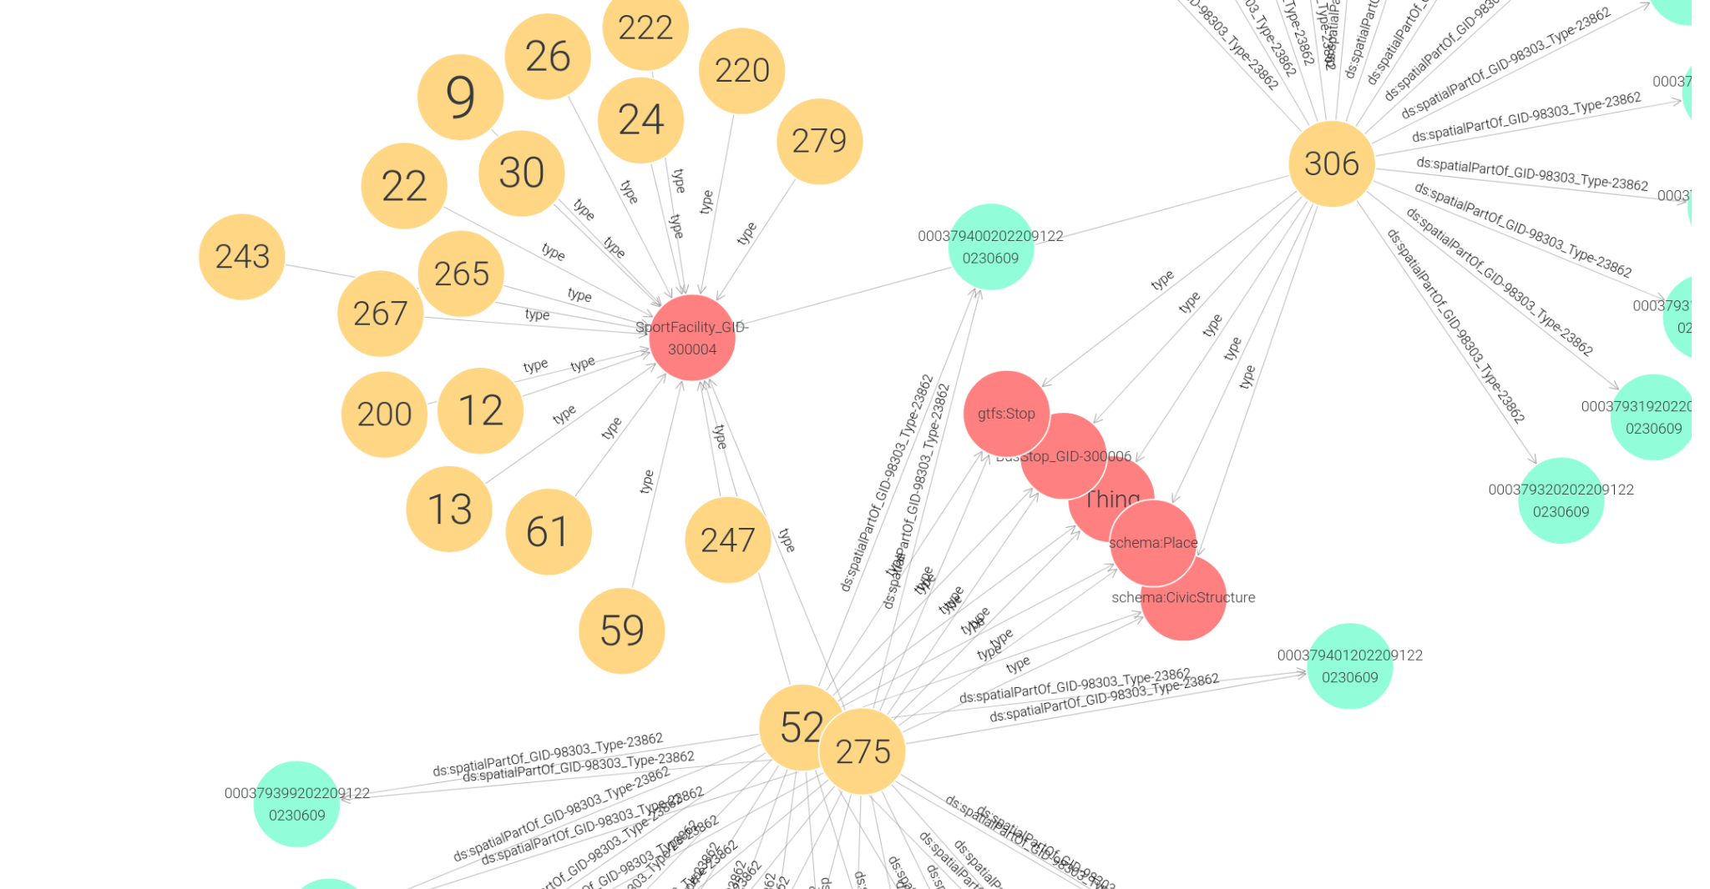
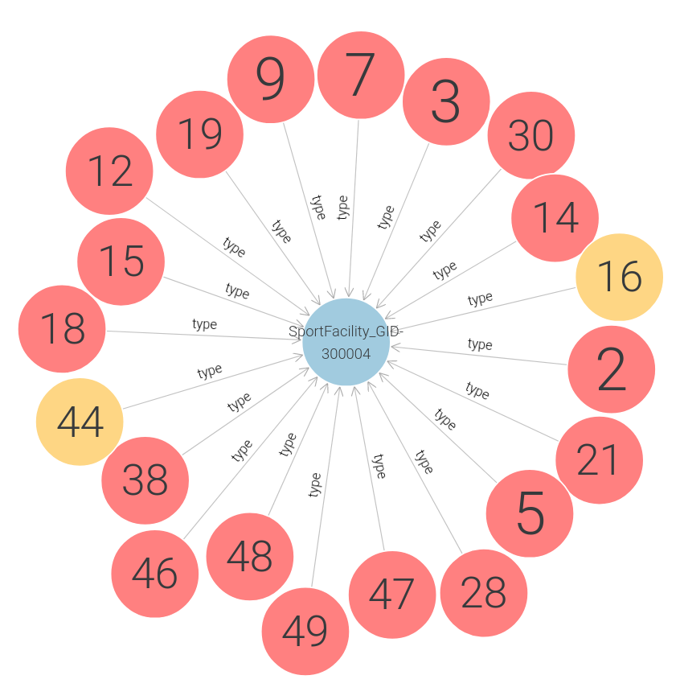
KGC
Finally the KG is built:
Main tool GraphDB
Retrieved files from karma are exploitable in GraphDB
GraphDB permit a visual representation of the KG
Notes:
Shandy Darma

Slide 23
KG coverage and metrics
 | Etype Coverage | Property Coverage
ETG vs CQs | 0.64 | 1.0
ETG vs Reference Ontologies | 1.0 | 0.23
Entity Connectivity | Data Property Connectivity | Object Property Connectivity
4,386 | 17,706 | 16,121
Notes:
Shandy Darma
all of the etypes we extracted from the ROs are relevant; none of them are dropped

Slide 24
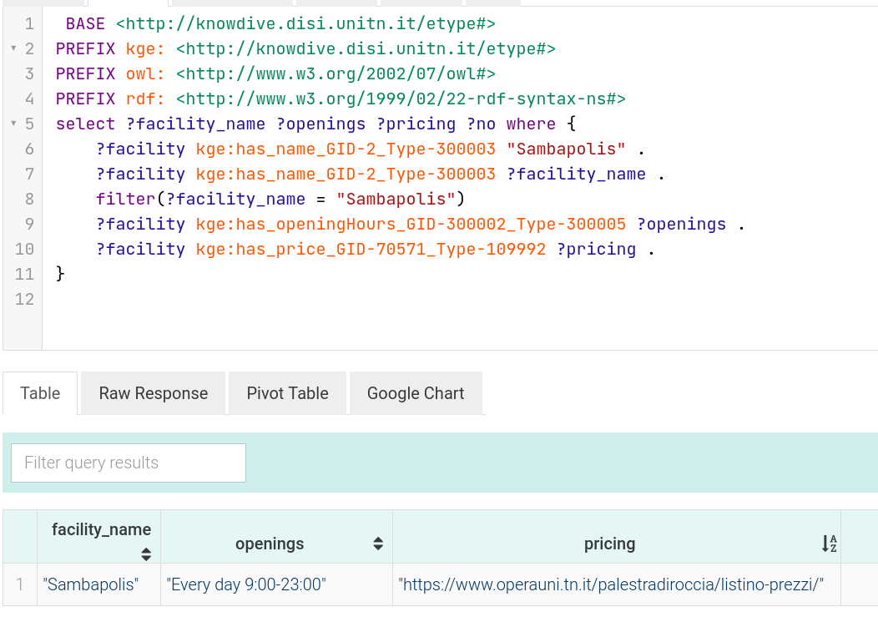
Exploitation
This step shows how the graph can be used:
Main tools GraphDB and SPARQL
Both visual and query exploitation
Run queries to retrieve informations from the KG
Notes:
ERIK Nielsen

Slide 25
Open Issues
The results returned some open issues:
Schema mostly good for the purpose, some optimization needed
Some more datasets required for the purpose (e.g. SportOrganization and SportEvent)
Better understanding of the semantic heterogeneity and fixage (e.g. inside entity matching)
Notes:
Shandy Darma

Slide 26
Conclusions
In conclusion:
the iTelos methodology was used to create the KG
the given purpose was followed to retrieve a suitable KG
the KG was exploited
iTelos methodology became a tool to discover KGE and Data Integration field
Notes:
ERIK Nielsen

Slide 27
Thank you for your attention

